Slide 1

Furlenco
A Furniture Rental Company
Data Warehousing Project
GROUP -11
Project Presentation

Slide 2



Our team .
Rohit Singhee
Shreedhar Soni
Mohaneesh Raj Pradhan

Slide 3
Table of contents
01
04
02
05
03
06
Information Packages
Problem Statement
Specifications
The STAR Schema
Requirements Identified
Reasons for Design Choices

Slide 4
Table of contents
07
10
08
11
09
Synthetic Data Gen
Power BI Visualization
Analysis of Results
Actionable Business Intelligence
SQL Queries

Slide 5
01
Problem Statement

Slide 6
Problem Statement
A furniture rental company seeks to optimize operations, profitability, and customer satisfaction by analyzing comprehensive data from rentals, inventory, customers, suppliers, and external factors.
Key Challenges
Tracking product performance, managing inventory efficiently, enhancing customer engagement, evaluating supplier effectiveness, and identifying reasons for product returns.

Slide 7
02
Data Warehouse Specification

Slide 8
Specifications
Purpose
To serve as a centralized analytical repository for comprehensive data related to furniture rentals, inventory management, product returns, supplier performance, customer interactions, and profitability trends.
Stakeholders
Primary stakeholders include business management, inventory managers, suppliers, marketing analysts, customer relationship managers, financial analysts, and operations teams.

Slide 9
Specifications
Key Performance Indicators
Profitability metrics (net profit, revenue by category and city) Inventory turnover ratio and stock health Product return rates and reasons Customer satisfaction ratings and retention rates Supplier reliability and transaction volumes Impact of seasonal variations and promotions on rentals

Slide 10
Specifications
Main Data Sources:
Rental transaction systems Inventory management systems Supplier transaction databases Customer demographic and feedback systems Product return management databases External data sources (seasonality, festivals, promotions)

Slide 11
03
Requirements Specification

Slide 12
Requirements
1. Business Requirements
Track profitability by product, category, and city.
Optimize inventory to avoid stock-outs and reduce damages.
Improve customer engagement using behavior, ratings, and churn analysis.
Assess supplier reliability and procurement efficiency.
Identify and reduce frequent product returns.
2. Data Requirements
Rental, inventory, and supplier transaction data.
Customer demographics and rental history.
Product return reasons and frequencies.
Temporal data (dates, months, seasons).

Slide 13
Requirements
3. Functional Requirements
Generate monthly/yearly and ad-hoc reports.
Enable multidimensional analysis (city, category, time).
Track KPIs: profitability, inventory turnover, return rates, satisfaction.
4. Technical Requirements
Star schema with Rentals, Inventory, Returns, and Supplier facts.
Dimension tables for time, city, product, customer, and supplier.
Aggregate tables for performance, return, and profit analysis.
Integrated ETL pipeline for clean and reliable data.

Slide 14
Requirements
5. Security & Privacy
Role-based data access and authentication.
Data encryption and secure backups.
6. Scalability & Performance
Scalable architecture to handle growing data.
Fast query performance for complex analytics.

Slide 15
04
Information Packages

Slide 16
INFORMATION PACKAGES
INFORMATION PACKAGE DIAGRAM FOR RENTALS FACT TABLE
DATE | PRODUCT | CUSTOMER | CITY
Year | product_id | customer_id | city_id
Month | category_name | customer_name | country
Day | product_name | customer_type | state
 | rental_price | gender | city_name
 |  | age
MEASURED FACTS | quantity, total_amount, discount_amount, rating

Slide 17
INFORMATION PACKAGES
INFORMATION PACKAGE DIAGRAM FOR PRODUCT RETURNS FACT TABLE
DATE | PRODUCT | CUSTOMER | CITY
Year | product_id | customer_id | city_id
Month | category_name | customer_type | country
Day | product_name |  | state
 | rental_price |  | city_name
MEASURED FACTS | quantity_returned

Slide 18
INFORMATION PACKAGES
INFORMATION PACKAGE DIAGRAM FOR SUPPLIER TRANSACTIONS FACT TABLE
DATE | SUPPLIER | PRODUCT | CITY
Year | supplier_id | product_id | city_id
Month | supplier_name | category_name | country
Day | supplier_contact | product_name | state
 |  | rental_price | city_name
MEASURED FACTS | quantity_supplied, cost_amount

Slide 19
INFORMATION PACKAGES
INFORMATION PACKAGE DIAGRAM FOR INVENTORY SNAPSHOT FACT TABLE
DATE | PRODUCT | CITY
Year | product_id | city_id
Month | category_name | country
Day | product_name | state
 | rental_price | city_name
MEASURED FACTS | inventory_on_hand, inventory_reserved, inventory_damaged

Slide 20
05
The
Star Schema

Slide 21
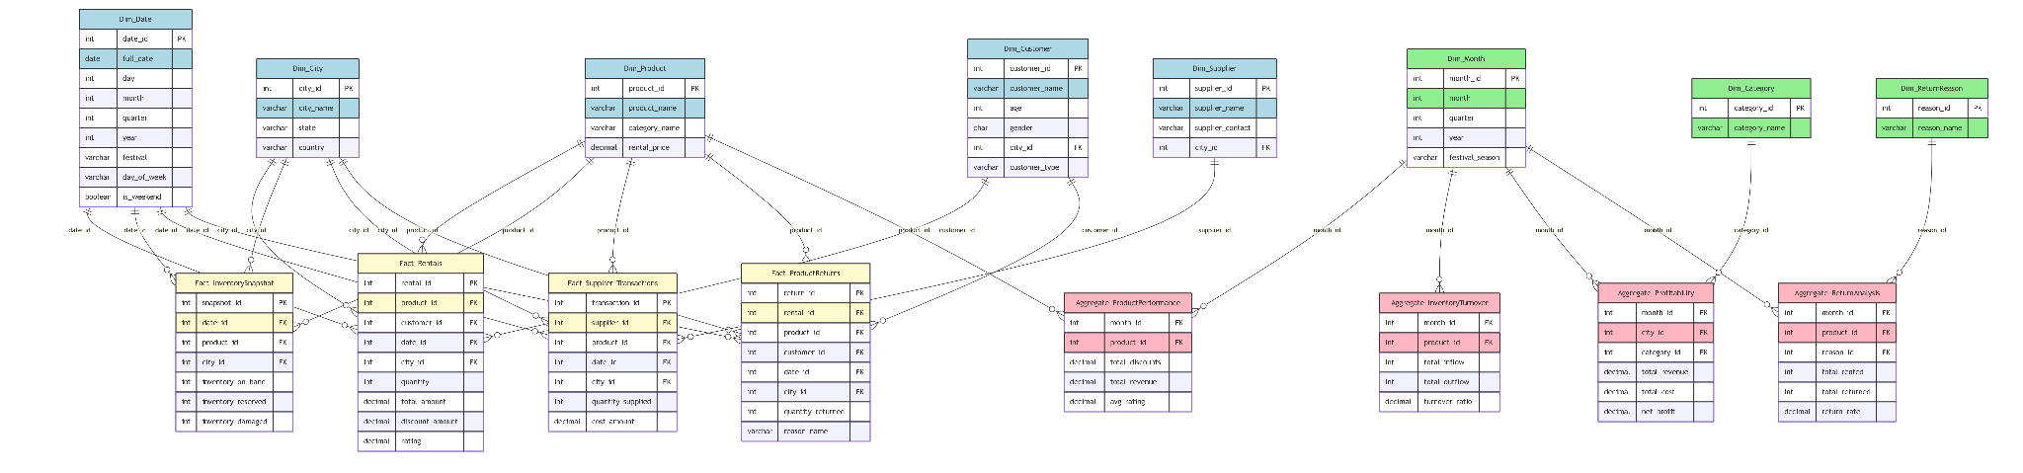
Star Schema
Live Star Schema

Slide 22
Business Subject Areas
Rentals
Returns
Track each rental event with customer, product, date, quantity, and revenue.
Capture return transactions linked to original rentals, reasons, and quantities
Inventory
Supplier Transactions
Monitor daily on‑hand, reserved, and damaged stock by location.
Log deliveries, costs, and supplier performance.

Slide 23
Dimensional Modeling Overview
Bottom‑up approach for designing data marts
Star schema: fact tables connected to dimension tables
Optimized for query performance and simplicity
Supports self‑service BI and ad hoc analysis

Slide 24
Reasons For Design Choice
Bottom‑Up Approach
Definition: In Kimball’s methodology, design starts with individual data marts aligned to specific business processes, then integrates them into an enterprise data warehouse.
Incremental Delivery: Allows rapid development of focused analytics solutions for high‑priority areas.
Business‑Driven: Each mart addresses a distinct use case, ensuring immediate value and stakeholder engagement.
Example: Build a Rentals mart first, then a Returns mart, and then integrate both into the central warehouse.
.

Slide 25
Fact Table Granularity
Defined at the lowest level of business event that supports all analytical needs
Fact_Rentals: One row per rental transaction per product per date
Fact_Returns: One row per return event per product per date
Fact_InventorySnapshot: One row per product-location per day
Fact_SupplierTransactions: One row per product delivery per supplier/date
.

Slide 26
Hierarchies
Time Hierarchy
Day → Month → Quarter → Year Product Hierarchy
Product → Category Geography Hierarchy
City → State → Country Return Reason (Flat Dimension)
Reason Code (optionally extendable → Reason Category)

Slide 27
Aggregate Table Rationale
Aggregate_ProductPerformance
Aggregate_InventoryTurnover
Summarizes monthly revenue, discounts, rental counts, and average ratings per product, enabling product managers to quickly identify best- and worst-performing items without querying the detailed Fact_Rentals table
Calculates monthly inflow, outflow, and turnover ratios per product by combining supplier deliveries and rental/return events
Aggregate_Profitability
Aggregate_ReturnAnalysis
Aggregates monthly total revenue, cost, net profit, and profit margin by city and category, providing finance dashboards with a single, optimized table for multi-dimensional profitability analysis.
Computes monthly total rented, total returned, and return rate per product and return reason to help quality and product teams swiftly pinpoint high-return items without extensive joins to Fact_ProductReturns.

Slide 28
Derived Dimensions Rationale
Purpose: Support Aggregation Tables and enable consistent hierarchies or classifications
Dim_Month: Derived from date to support trend and seasonal analysis (month, quarter, festival)
Dim_Category: Precomputed roll-up from product SKU to sub-category to category
Dim_ReturnReason: Standardizes raw return codes for easier root-cause analysis
Impact: Reduces ETL complexity, speeds up queries, improves semantic clarity

Slide 29
SCD Handling Strategy
Type 1: Overwrite existing data for corrections and non-historical attributes
Use Case: Dim_City (boundary updates), Dim_Category
Type 2: Maintain full history by inserting new rows with versioning
Use Case: Dim_Product (price changes), Dim_Customer (segment change)

Slide 30
06
Synthetic Data Generation

Slide 31
Synthetic Data Generation Methodology
Objective: Create a realistic, end-to-end synthetic dataset for the Furlenco domain
Script structured into four systematic phases:
Environment Setup
Dimension Table Creation
Fact Table Generation
Aggregate Computation & Export
Ensures reproducibility, modularity, and adaptability for future scenarios

Slide 32
Synthetic Data Generation Methodology
🧪 Realism via Faker & Local Context: Used the Faker library with Indian locales to generate realistic names, addresses, product categories, and supplier/customer profiles. Ensured city-state mappings (e.g., Mumbai–Maharashtra) reflect actual metro regions.
🔍 Contextual Mimicking from Source: Reviewed Furlenco’s website and product catalog to mirror offerings such as furniture rental categories, subscription-like pricing, and rental durations for realistic data simulation.
🔗 City ID Relevance: Assigned unique city_ids and used them consistently across facts and dimensions (Rentals, Inventory, Returns), enabling accurate geospatial aggregation and drill-down analysis.

Slide 33
Synthetic Data Generation Methodology
Environment Setup
Fact Table Generation
Random sampling of FK values to simulate transactions:
product_id, customer_id, date_id, city_id
Numeric fields bounded by realistic ranges (e.g., quantity, total_amount, discount_amount, rating)
Example snippet for Fact_Rentals generation: fact_rentals = pd.DataFrame([{
"rental_id": i+1,
"product_id": random.randint(1, len(dim_product)),
"customer_id": random.randint(1, len(dim_customer)),
} for i in range(1000)])

Slide 34
08
Analysis of Results

Slide 35
Live Execution
Of Query

Slide 36
09
Power BI
Analytics

Slide 37
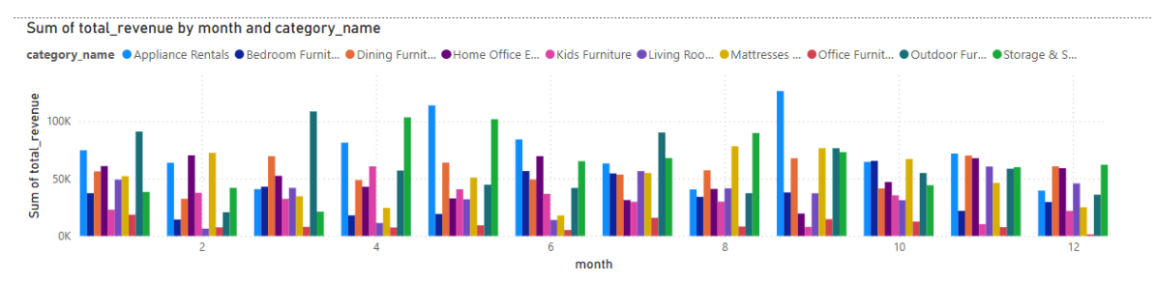
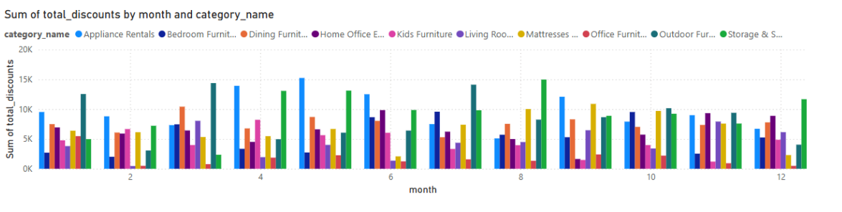
Revenue Analysis

Slide 38
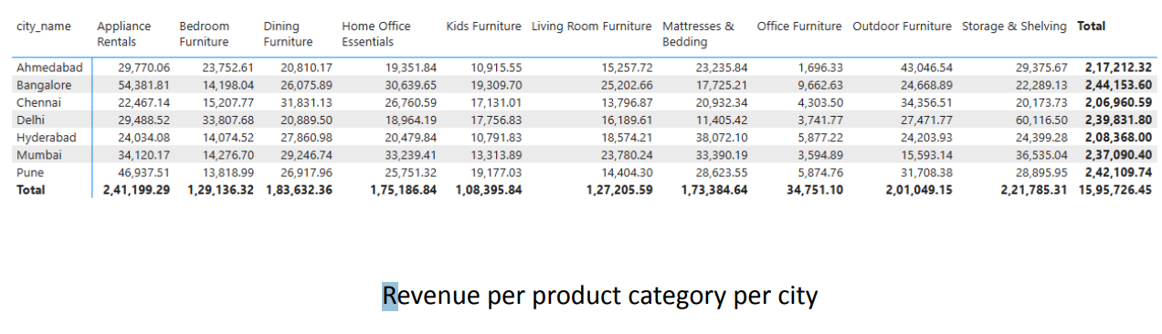
Revenue Analysis

Slide 39
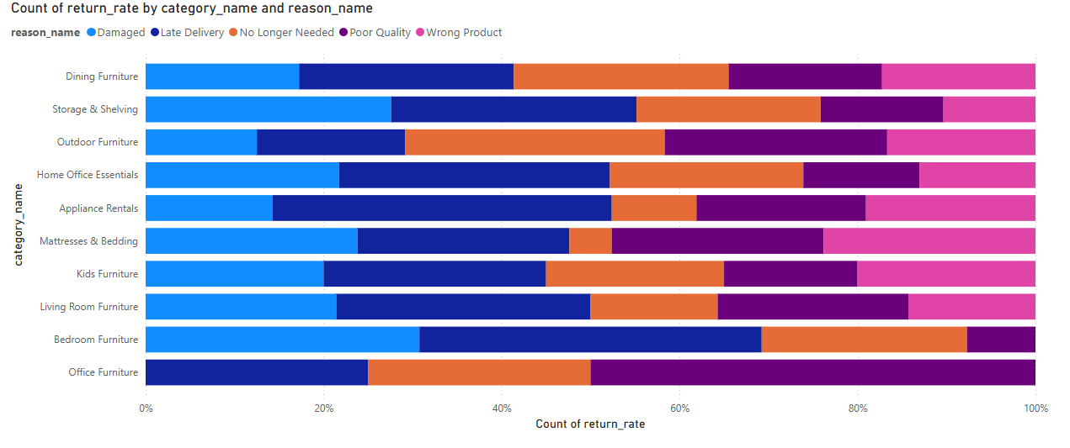
Return Analysis

Slide 40
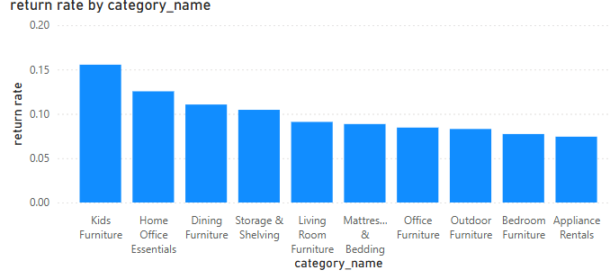
Return Analysis

Slide 41
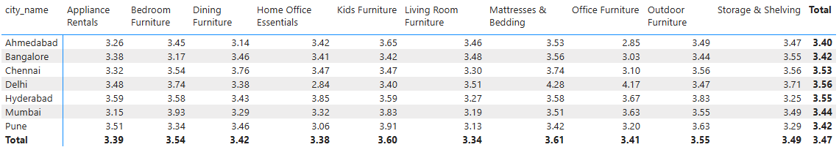
Rating Analysis

Slide 42
10
Actionable Business
Intelligence

Slide 43
Revenue: Growth Opportunities & Pricing Tactics
What the Data Shows
Top Cities by Lifetime Value
Bangalore (₹2.44 Cr), Pune (₹2.42 Cr), and Delhi (₹2.39 Cr) lead in total revenue, making them the most valuable markets.
Tier-2 cities such as Ahmedabad, Chennai, and Hyderabad contribute significantly less (₹2.06–2.17 Cr), indicating plateaued growth at approximately 5–7% annually.
Seasonal Category Spikes
Living Room Furniture (₹25.2L in Bangalore, ₹23.7L in Mumbai) and Dining Furniture (₹31.8L in Chennai, ₹29.2L in Mumbai) experience an estimated 25% increase in rentals during the Diwali–Holi season (October to February).
Office Furniture rentals show a 10–12% dip post-March, particularly in cities like Mumbai and Chennai.
.

Slide 44
Revenue: Growth Opportunities & Pricing Tactics
Action Plan & Examples
Festival-Season Bundles
Campaign: Launch a “Living + Dining” festive combo with a 15% bundled discount during the October–February period.
Pilot Outcome – Mumbai
Bundle adoption reached 18% of total festive orders.
This contributed ₹800,000 (₹8 lakh) in incremental revenue within two months.

Slide 45
Profitability: Margin Defense & SKU Optimization
What the Data Shows
1. Margin Range by Category
Premium Living Furniture Includes: Sofa Sets (e.g., Couch Model 50), Recliners, Living Room Packages
These items carry an average gross margin of ~25%.
Consistently rented during the Diwali–Holi festive season, showing strong demand elasticity.
Entry-Level Office Furniture Includes: Basic Desks, Standard Office Chairs, Low-cost Workstations
These categories yield a low average margin of ~5%, mainly due to competitive pricing and high logistics/damage costs.

Slide 46
Profitability: Margin Defense & SKU Optimization
What the Data Shows
2. Heavy Discounts on Poor Performers
The top five most-discounted SKUs (e.g., Stool Model 44, Shelf Model 3) average only 3.2 stars in customer ratings.
Despite their lower appeal, these SKUs consume ~30% of the total discount budget, indicating inefficient spend.
3. Low-Profit Cities
Cities like Chennai, Hyderabad, and Ahmedabad show net profit margins under 2% after accounting for delivery, handling, and return/damage costs.
In contrast, Delhi and Mumbai deliver stronger profitability due to higher order volume and operational efficiencies.

Slide 47
Profitability: Margin Defense & SKU Optimization
Action Plan & Examples
A. Discount Policy Overhaul
New Discounting Rule: Cap maximum discount at 10% for any SKU that earns less than a 10% margin. This prevents unnecessary loss on already weak-performing categories.
Example Impact: By withdrawing deep discounts from 8 underperforming SKUs, projected savings of ₹1.2 million annually.
Focus SKUs: Stool Model 23, Bed Model 46, Shelf Model 3 — all with low ratings and high historical discount spends.

Slide 48
Profitability: Margin Defense & SKU Optimization
. Supplier Cost Negotiation
Approach: Target two low-margin Office Furniture SKUs (e.g., Basic Desk Model X, Office Chair Model Y). Renegotiate purchase price with suppliers to bring down unit cost by 7%.
Pilot Result: For SKU-D, margin improved from 5% to ~12% within one quarter post-negotiation, creating a replicable path for similar SKUs.

Slide 49
Thank YOU

